Slide 1
Degradation Of Polymeric Materials For Multi-use And Re-use
Meghna Jayaraman
Jen Koevary PhD (Sarver Heart Center, Department of Biomedical Engineering, University of Arizona)
Arizona Space Grant Symposium
April 14th, 2018

Slide 2
The Problem
Why do we care?
As we look into long term space travel we can’t sustain the current magnitude of waste output
Routinely discarded waste may in fact be a reusable source
Potential Solutions:
Mandated limits on consumption and consumed materials
Limited standards of living
Reduced product efficiency
Get creative
Maximize the efficiency of waste management through the recycling and repurposing of materials
Encourages innovation and competition

Slide 3
Biomaterials in Tissue Engineering
Biomaterials in tissue engineering have a variety of applications from bone to muscle to skin
Biodegradable meshes for hernia and cardiac repair
Biodegradable scaffolds for bone growth and repair
Biodegradable synthetic skin analogues for burn injuries
It is crucial to characterize the appropriate mechanical parameters of these meshes, to support regeneration without impeding native tissue function
In cardiac applications, for example, a prolonged degradation period and high mechanical strength could restrict ventricular filling

Slide 4
Objectives
Develop and characterize a variety of methods to repurpose and customize the mechanical properties of pre-manufactured polymer meshes for multi-purpose use on Earth and in space
Our work is designed to elucidate these material characteristics of meshes to aid in handling, engraftment, and biodegradation

Slide 5
Methods
Two polymeric meshes were explored:
Polycarbonate and polylactide co-polymer
Polyglactin 910
Three methods of degradation:
Hydrolytic degradation (pH 7.4, 37°C)
Ethylene oxide chemical degradation
Ultraviolet photolytic degradation (254nm, 15mW)
Tensile testing
To extract the stiffness and maximum tensile strength
over the course of degradation

Slide 6
Hydrolytic Degradation
Simulates in-vitro degradation
pH 7.4, 37°C
Seven day degradation intervals
Photolytic Degradation
Ultraviolet light degradation
254 nm, 15 mW
12 hour exposure periods

Slide 7
Chemical Degradation
Ethylene oxide sterilization
12 hour exposures
Three stages:
Pre-conditioning
Temperature and humidity controlled to stimulate microorganism growth
Sterilizer
EtO gas injection
De-gasser
Remove lingering EtO particles

Slide 8
Tensile Testing
Young’s Modulus (Elastic Modulus)
Describes the tendency of an object to deform along an axis when opposing forces are applied along that axis
Stress(F/A) / Strain(mm/mm)
The more elastic a material, the lower its elastic modulus
Stiffness
Describes the rigidity of an object, the extent to which it resists deformation to an applied force
Force(N) / Displacement(mm)
Maximum Tensile Strength
The maximum force(N) a material can withstand while being stretched before breaking

Slide 9
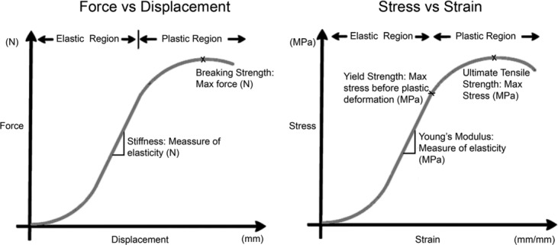
Tensile Testing
Kueckelhaus, Maximilian & Philip, Justin & Kamel, Rami & A Canseco, Jose & Hackl, Florian & Kiwanuka, Elizabeth & J Kim, Mi & Wilkie, Ryan & Caterson, Edward & Junker, Johan & Eriksson, Elof. (2014). Sustained Release of Amnion-Derived Cellular Cytokine Solution Facilitates Achilles Tendon Healing in Rats. Eplasty. 14. e29.

Slide 10
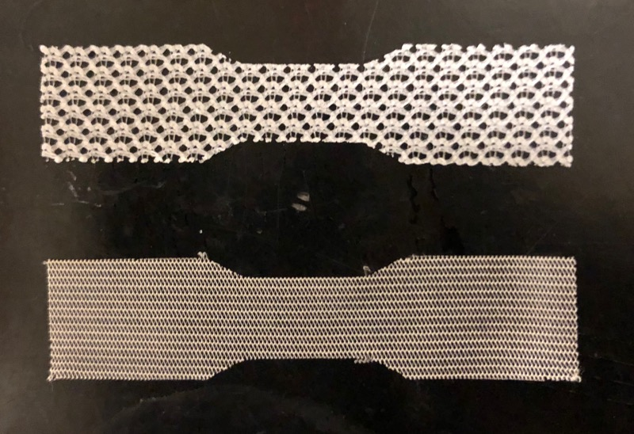
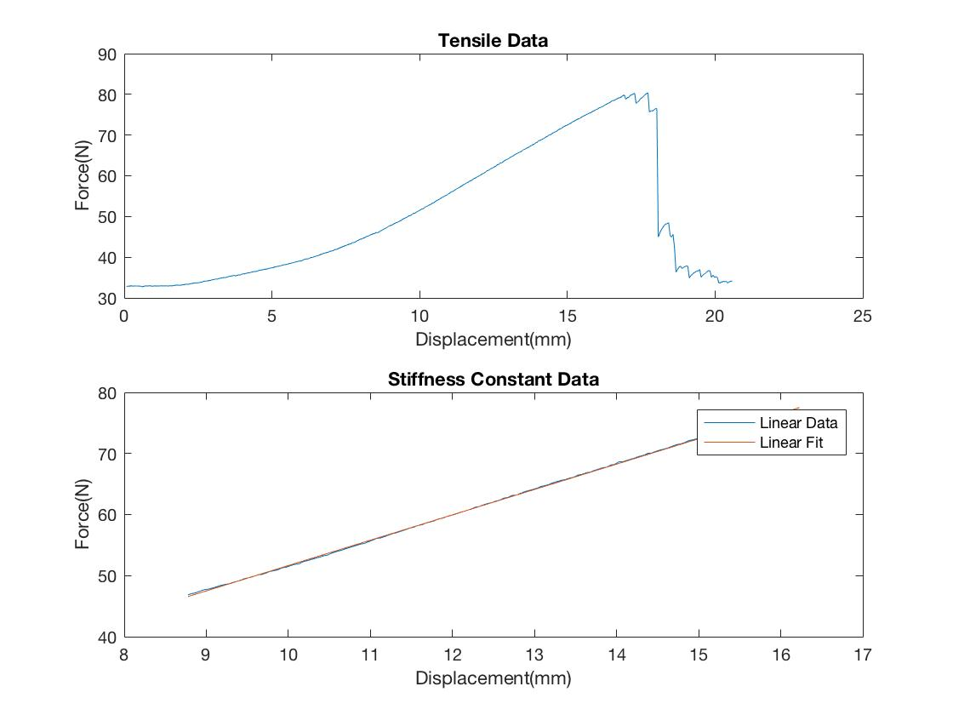
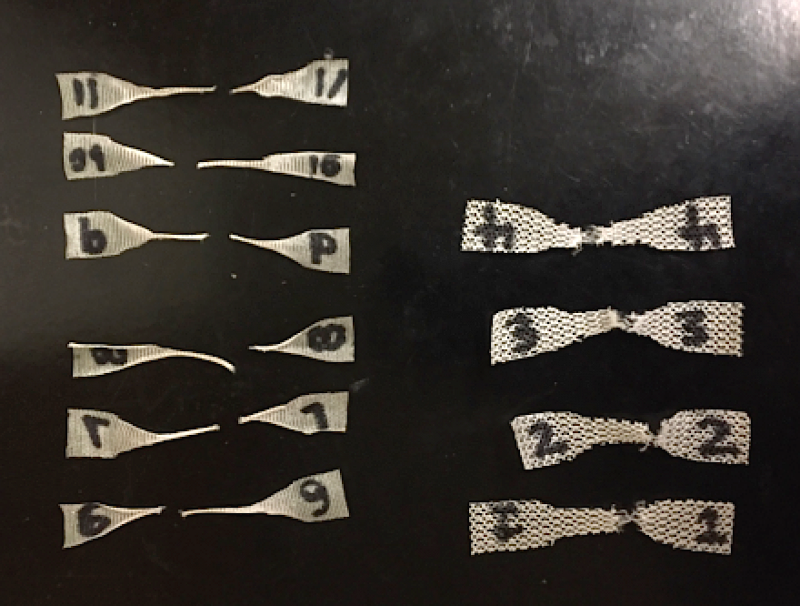
Tensile Testing

Slide 11
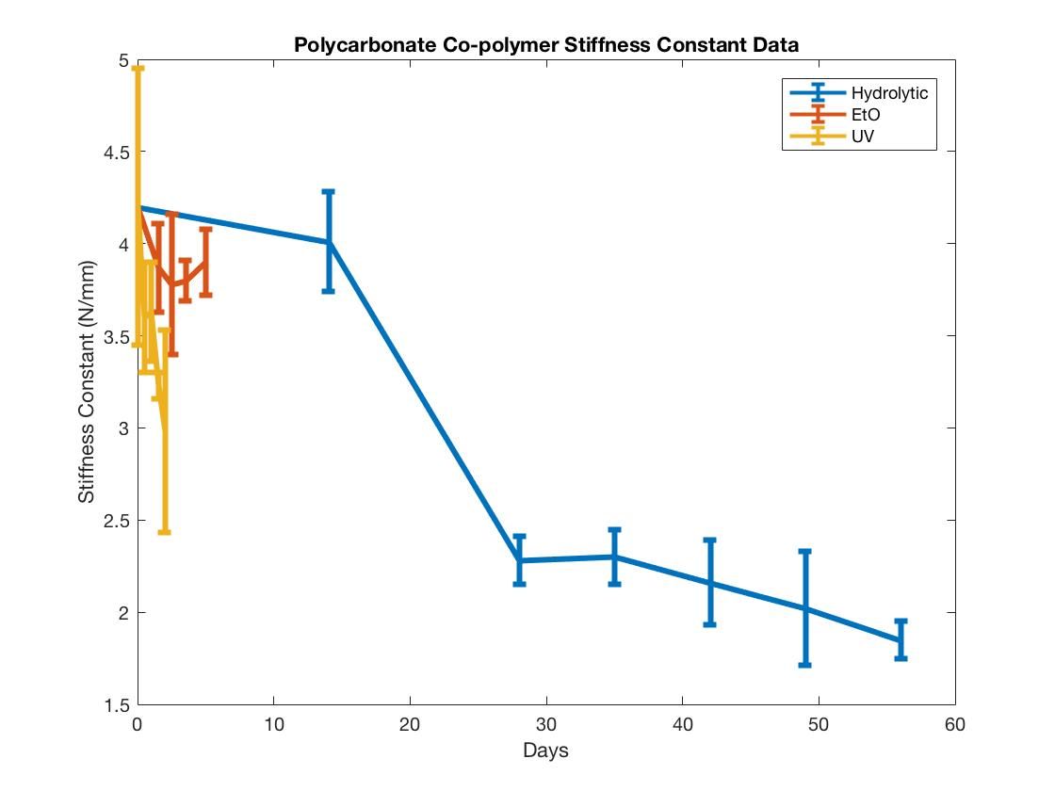
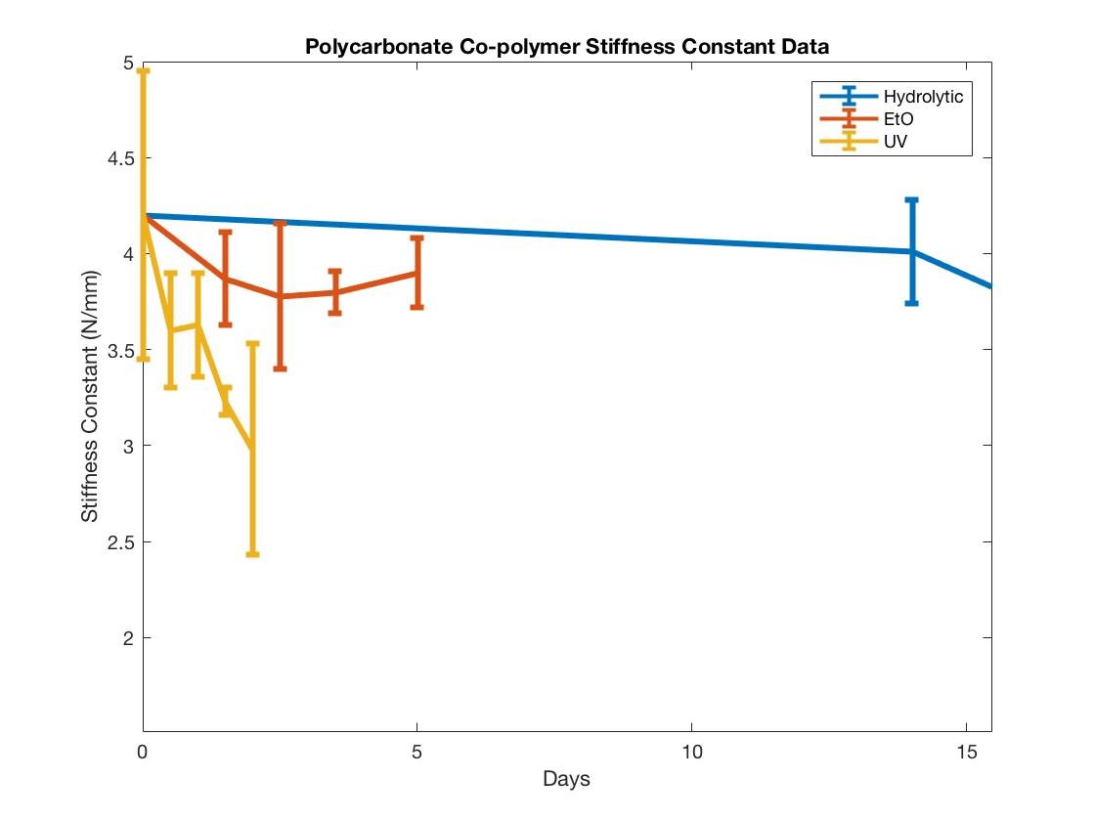
Polycarbonate Co-polymer Stiffness Constant Data

Slide 12
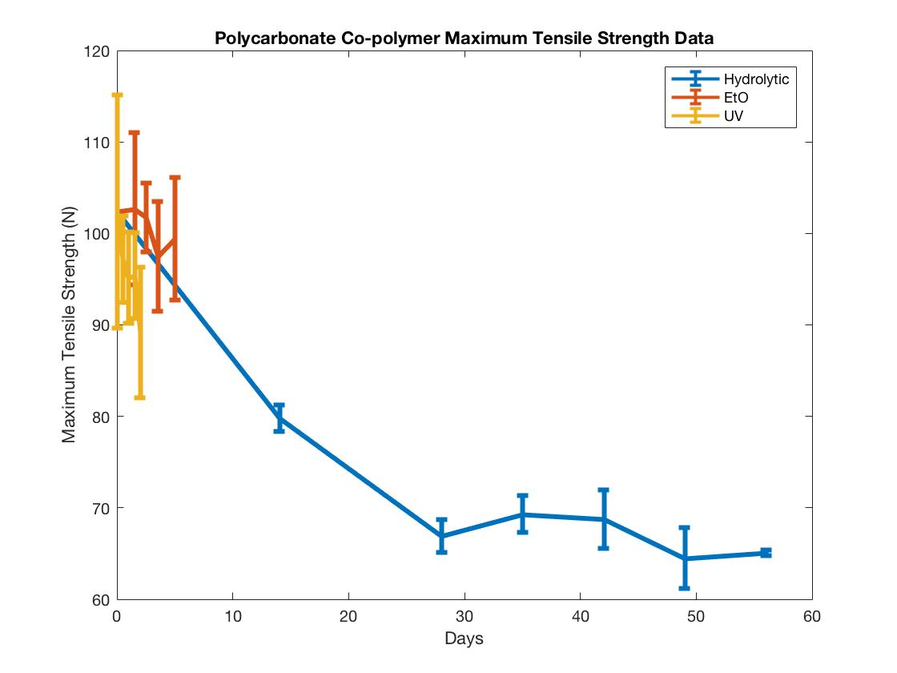
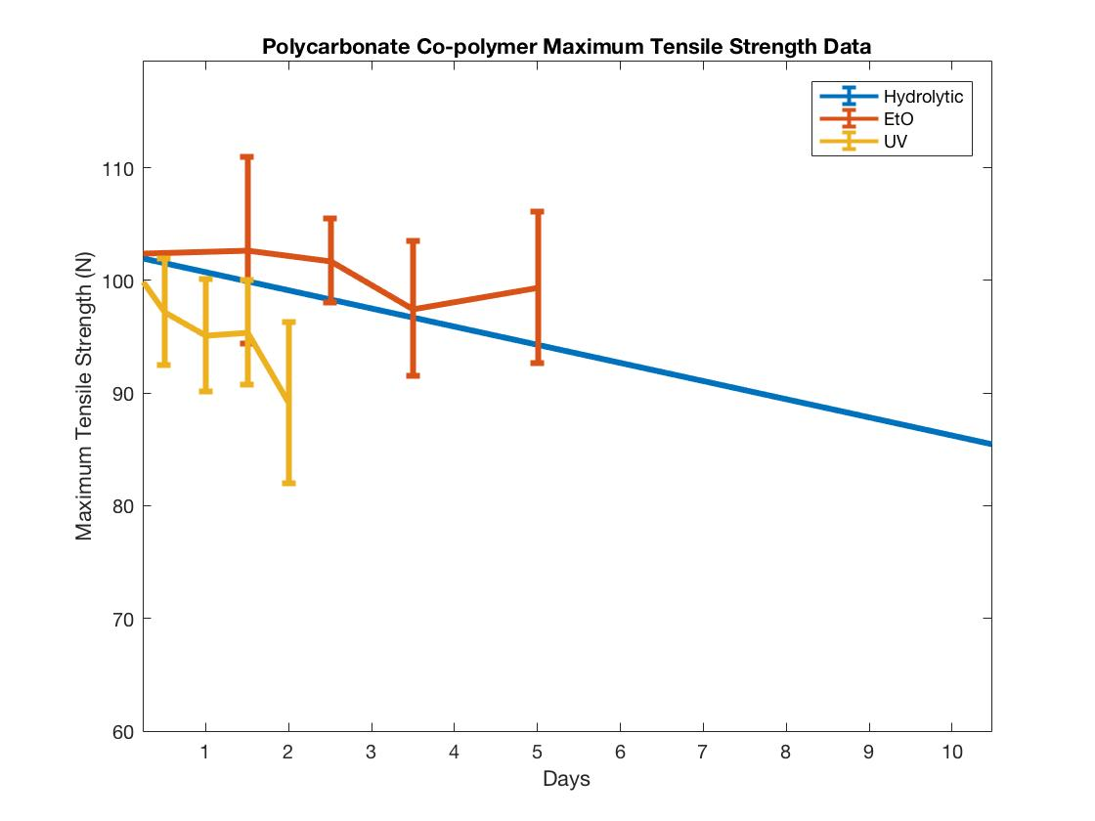
Polycarbonate Co-polymer Maximum Tensile Strength Data

Slide 13
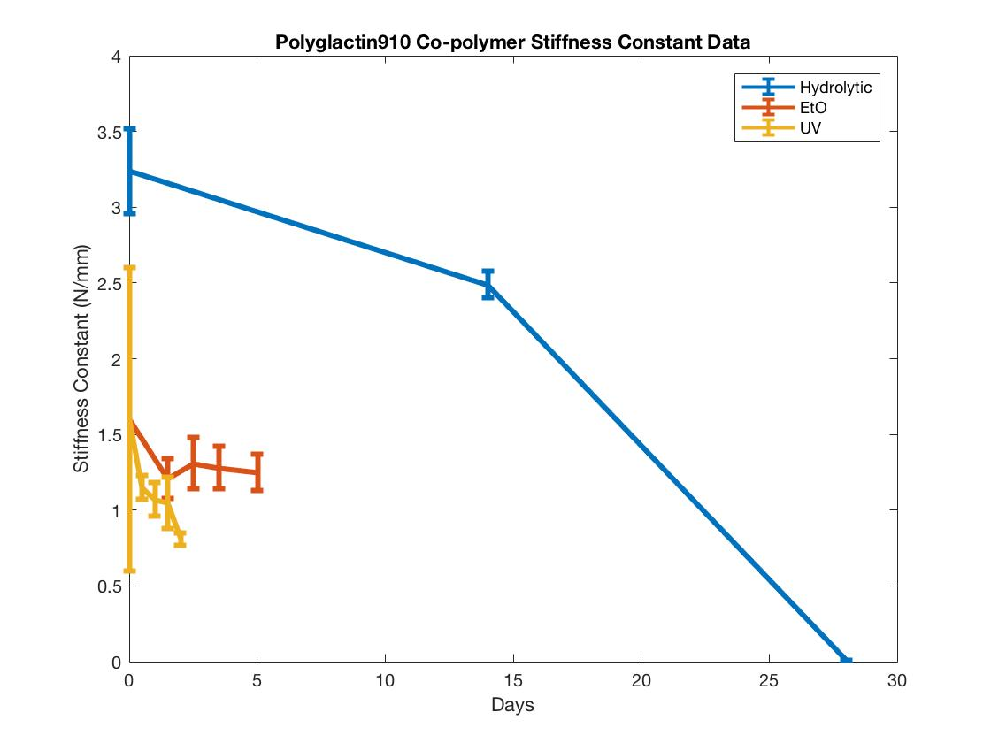
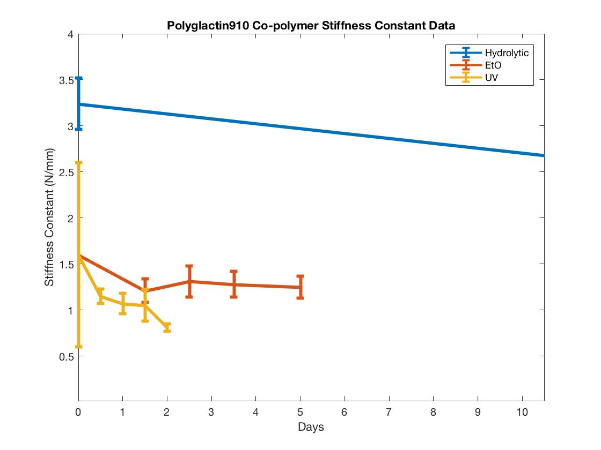
Polyglactin910 Co-polymer Stiffness Constant Data

Slide 14
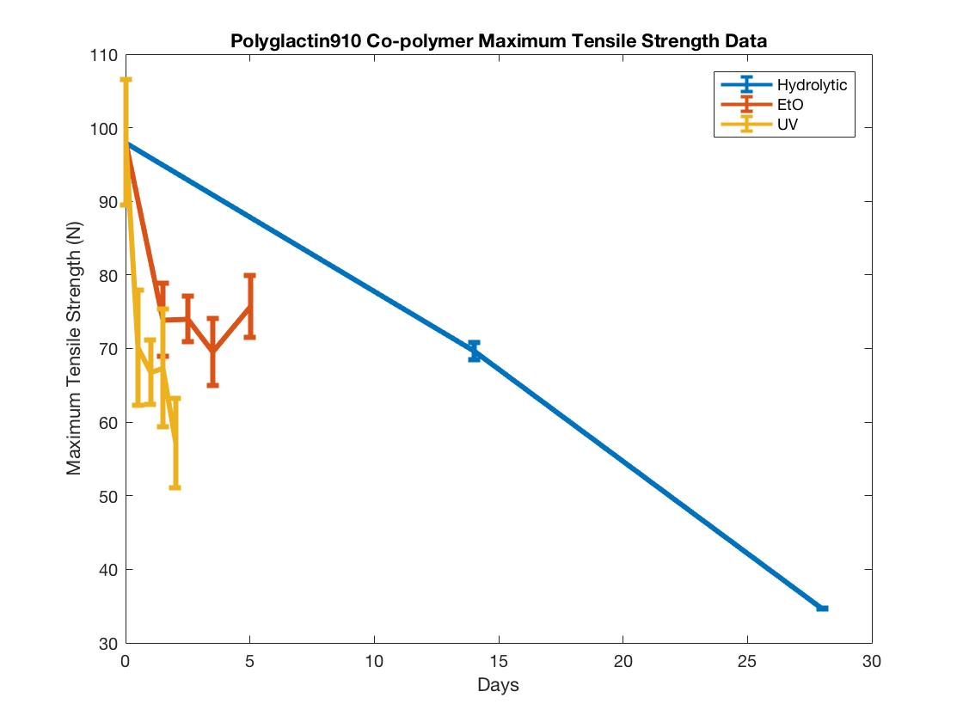
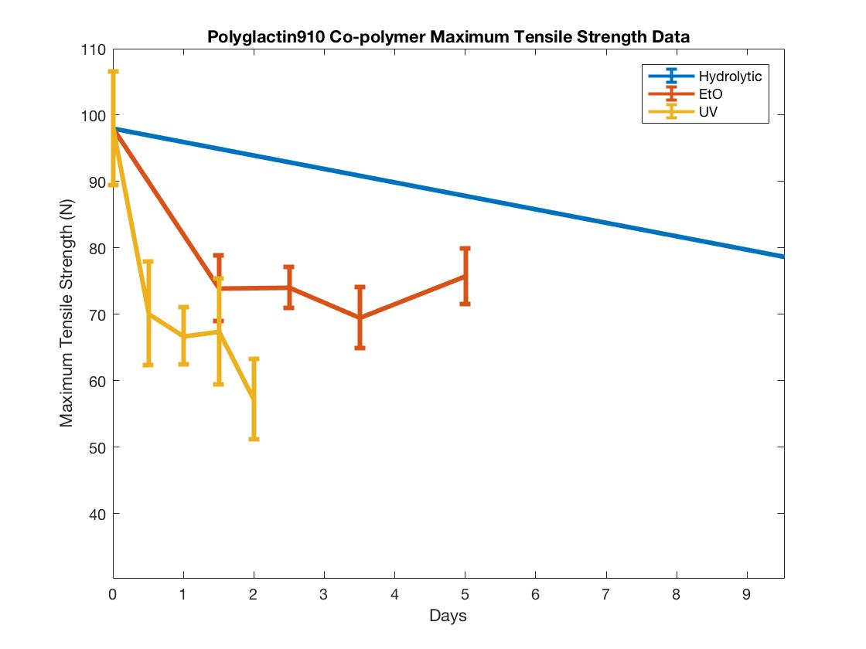
Polyglactin910 Co-polymer Maximum Tensile Strength Data

Slide 15
Conclusions
UV degradation is most effective
EtO degradation is least effective
Future Works:
Analyze the effects of combined degradation methods
Ex: UV and Hydrolytic Degradation of implanted biomaterials in space
Establish a model of polymer degradation to extrapolate potential material properties given a material and environment

Slide 16
The Big Picture
What does this mean for polymers in space?
EtO degradation and hydrolytic degradation are feasible in space but must be conducted in controlled environments such as metal encasings to limit simultaneous UV degradation
Aluminum can absorb approximately half the radiation it is exposed to
Light in the range of 200-300 nm is strongly absorbed in the stratosphere by ozone
Transmission of radiation of wavelengths below 290 nm is negligible below 10 km
Effects of photolytic degradation will play an important role in long term space travel
Negative: difficult to maintain material stability/integrity
Positive: for re-purposable materials this means that no extra effort needs to be put into degradation

Slide 17
Acknowledgements
Michele Tang (University of Arizona)
Sherry Daugherty (Sarver Heart Center, University of Arizona)
Jordan Lancaster PhD (Sarver Heart Center, University of Arizona)
Steven Goldman MD (Sarver Heart Center, University of Arizona)

Slide 18
Thank You

